Slide 1

Self Presentation
Ruochen Wu
Delft University of Technology

Slide 2
Overview
Basic Infor
MSc Researches
Earlier Projects

Slide 3



Educational Background
Central South University 09/2018 - 06/2022
B.Eng in Traffic Equipment and Control Engineering
GPA: 3.47/4.0
Delft University of Technology 09/2023 - today
MSc. in Multi Machine Engineering, Mechanical Engineering
GPA: 8.20/10

Slide 4
MSc Research Assignment (Soft Robotics)
Design and Control Strategy of a
Novel SMA-SMP Based Morphing Structure
Ruochen Wu¹, Aaron (Qianyi) Chen ¹, Jovana Jovanova ¹, T. V. G. Kalpoe ¹, Xinhai Zhou ¹
1 Delft University of Technology,
Duration: June 2024 – November 2024

Slide 5
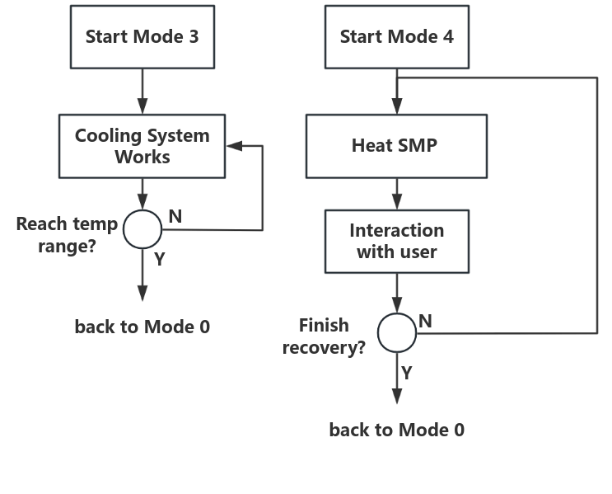
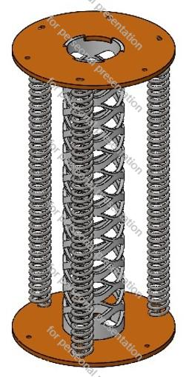
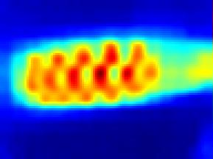

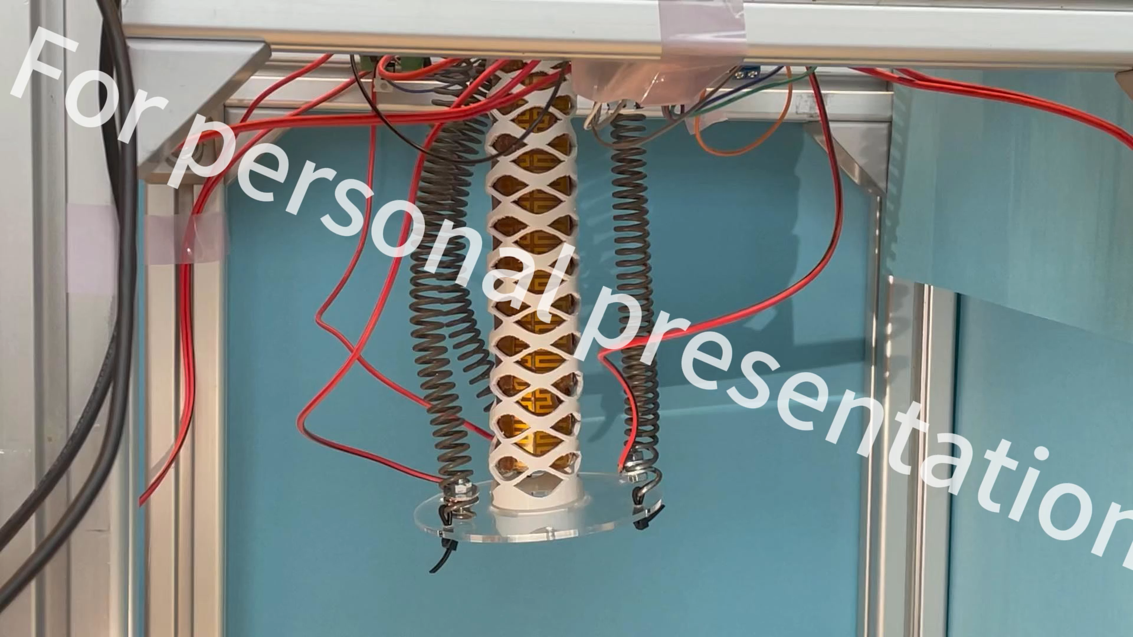
MSc Research Assignment Details
Shape Memory Actuators
Special Control Logic
IR Image Recognition
Prototype Fabrication & Exp

Slide 6
MSc Research Assignment Details
Contribution:
For the first time, a soft robot driven by shape memory materials has been developed to achieve continuous, rather than binary, motion.
A temperature detection approach based on unsupervised learning was introduced for the control of these complex structures.
A first-level control system, designed for user interaction, has also been developed.
Core Competencies:
Conceptual design and control logic development, with a focus on soft robotics
Proficient in Raspberry Pi and Arduino applications;
Image recognition (clustering);
Control platform programming;
Circuit design and PCB fabrication;
Experimental setup, data processing, and visualization (python).

Slide 7
MSc Graduation Project (Deep Learning & Data Mining)
Interpretable Intraday Price Prediction Using Kolmogorov-Arnold Networks and
Large Language Models
Ruochen Wu ¹, Runyao Yu ^{1, 2}, Esterl Tara ², Jochen Cremer ^{1,2}
1 Delft University of Technology, 2 Austrian Institute of Technology
Duration: October 2024 – June 2025 (expected)

Slide 8
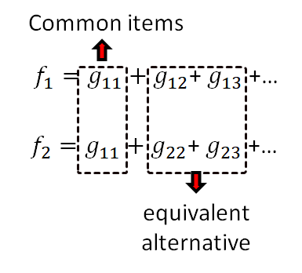
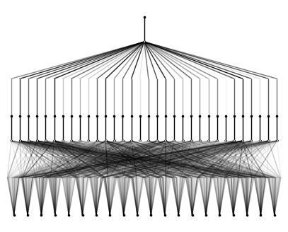
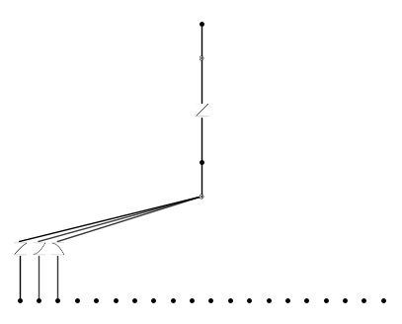
MSc Graduation Project Plan
Prediction model using KAN
Ensemble
(LLM)
Optimization algorithm
Maximize revenue
Models & Prediction
Application on trading strategies
Key words:
Neutral Networks (KAN & LLM);
Other benchmarks (MPL, CNN…);
AI for science;
Strategies based on forecasting.

Slide 9
Earlier Projects
Projects Overview
External Measurement Circuit for AFM (Visit Student) 02/2023-04/2023
Transmission of Coughing Droplets in a Train (Research Assistant) 04/2022-12/2022
Optimization Design of Air Duct in the Driver’s Cab of EMU (Undergraduate Thesis) 01/2022-05/2022
An Automatic Service Robot in Train Compartments 02/2021-07/2021
Road condition feedback system (Training Project) 04/2020-04/2021
College Students “Self-sufficiency” Program (Commercial Project) 02/2019-06/2020

Slide 10
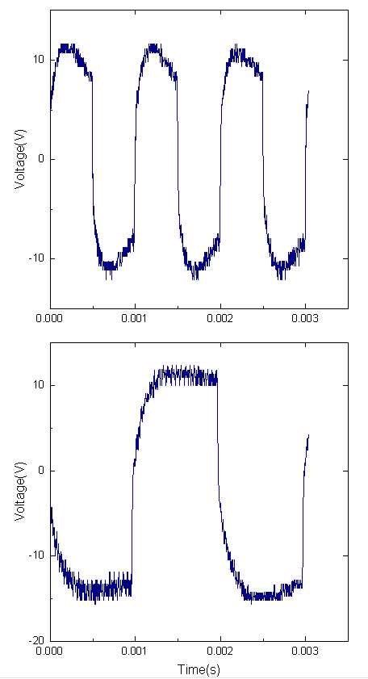
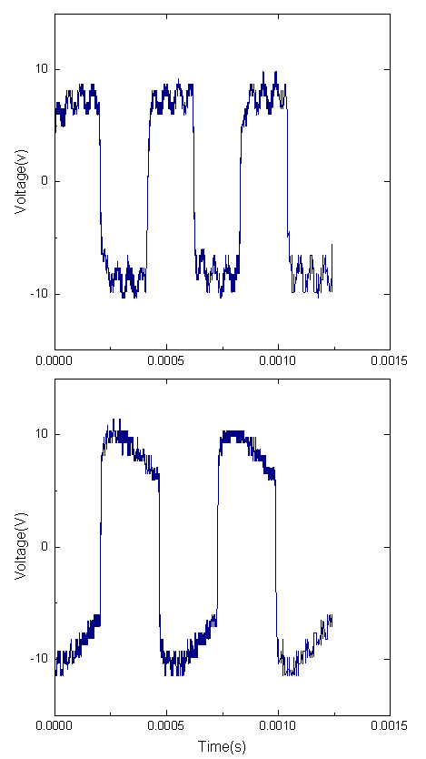
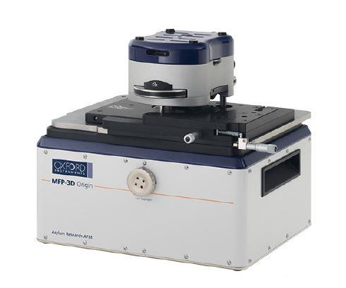
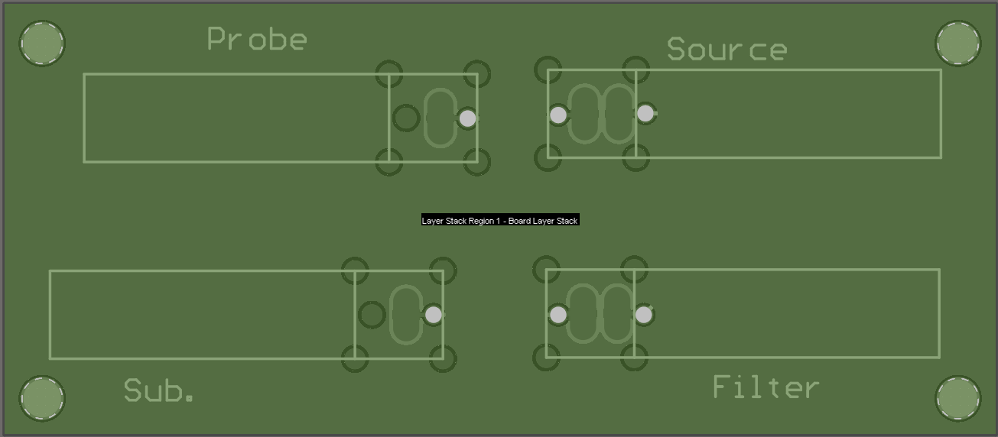
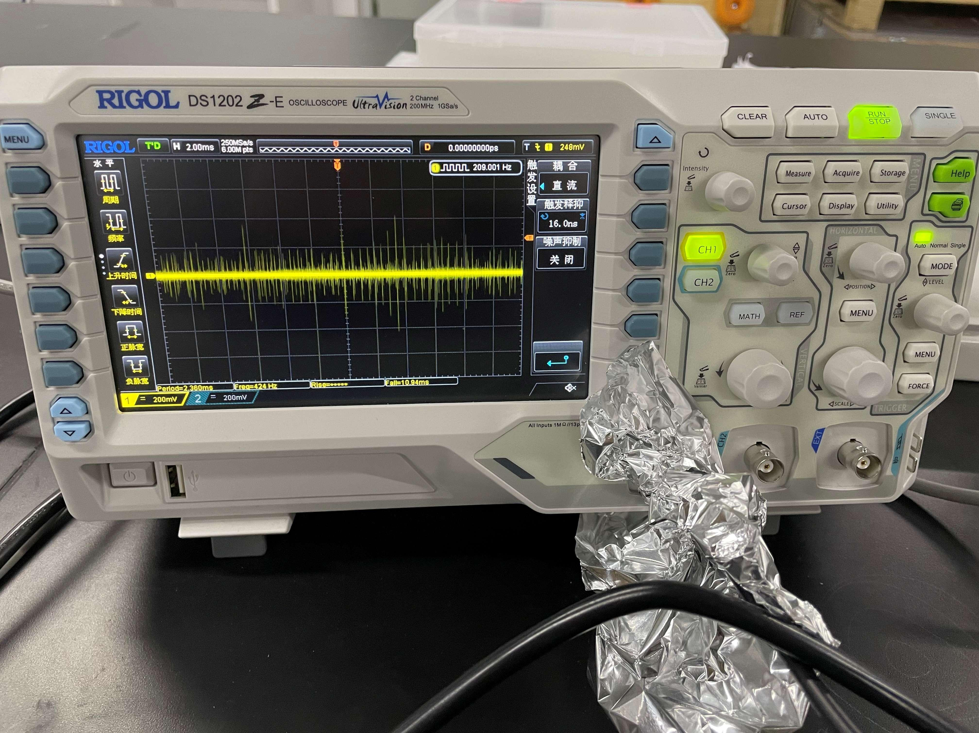
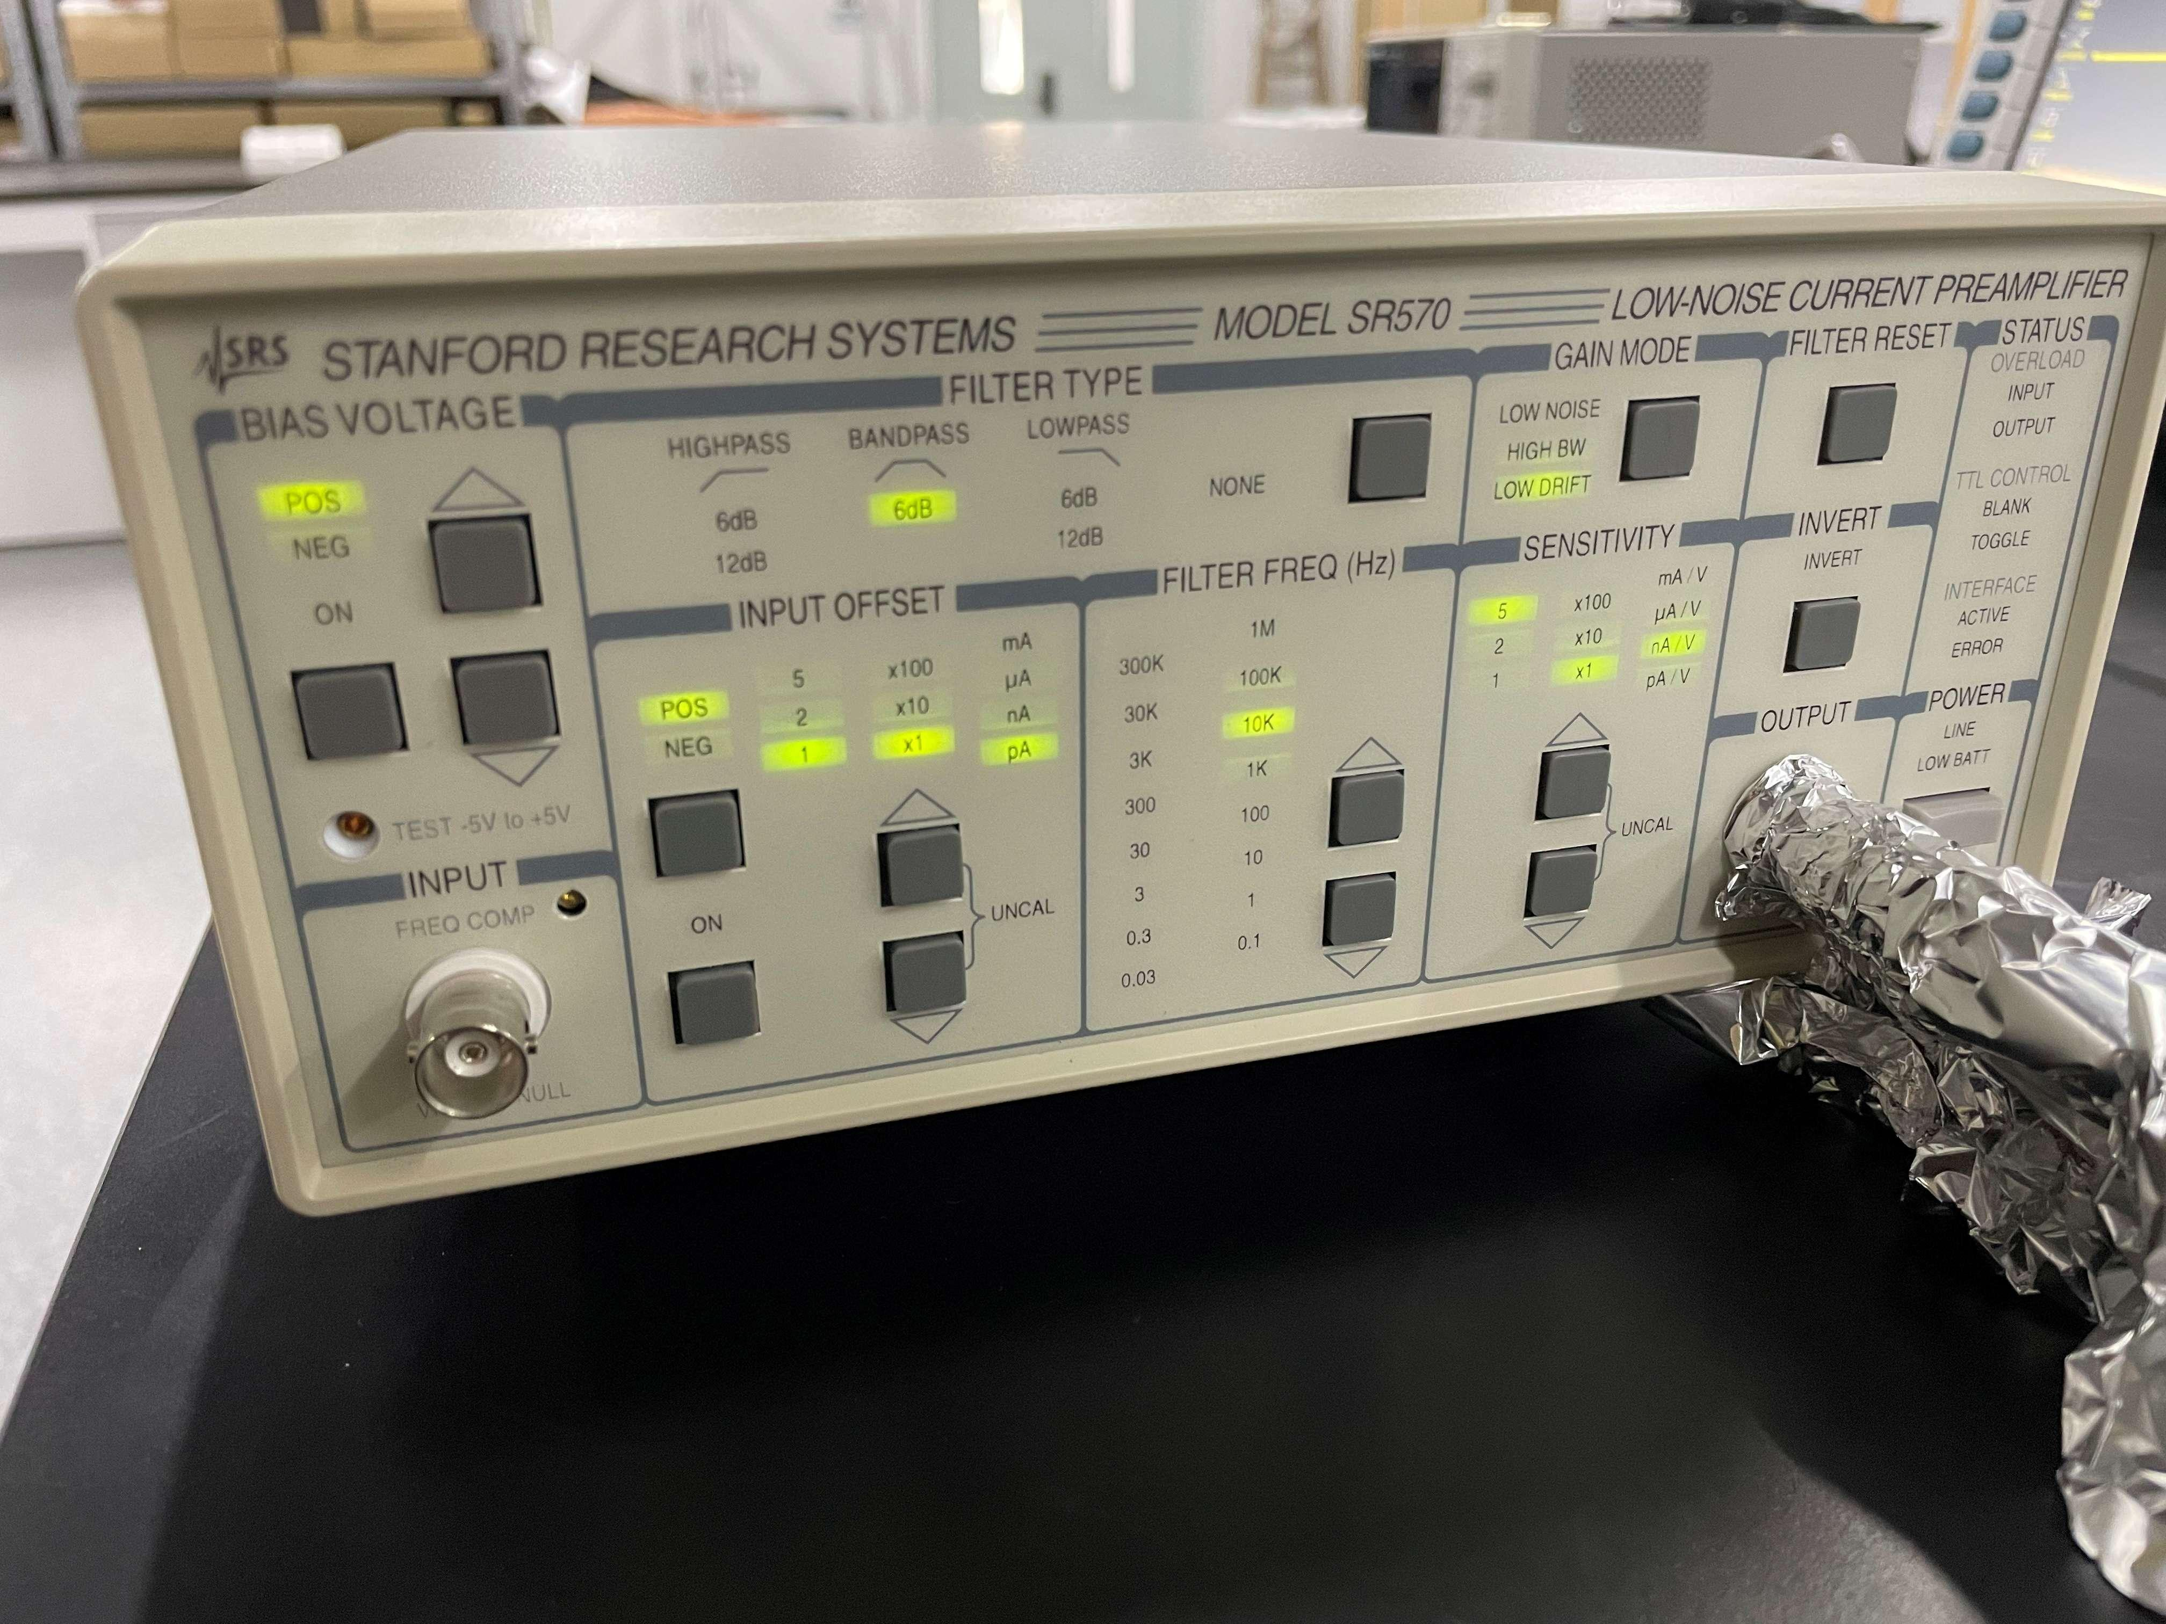
Functional Extension (Measurement)
1kHz
5kHz
Core Competencies :
Circuit design (Altium Designer) & fabrication;
Signal analysis and measurement;
Fundamentals of Atomic Force Microscopy (AFM);
Noise reduction techniques.
500Hz
2kHz
Macro-scale
Nano-scale

Slide 11
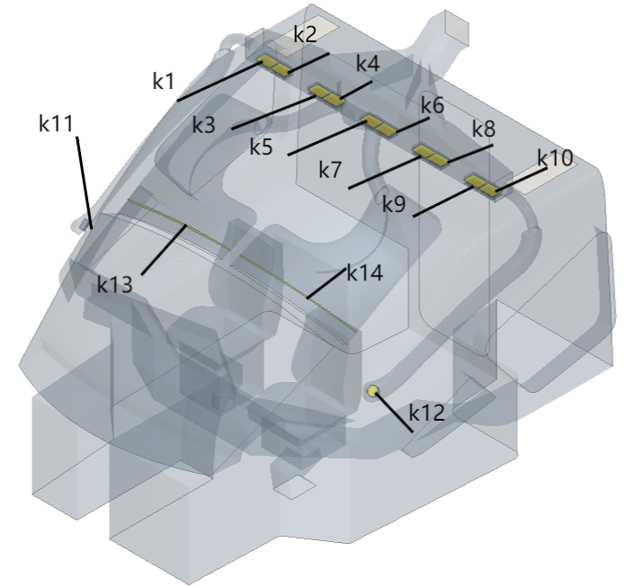
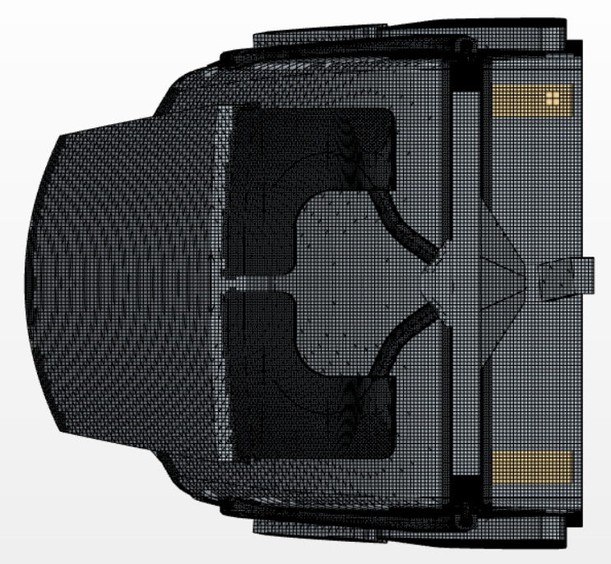
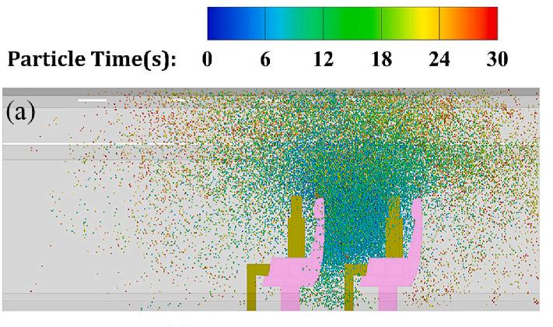
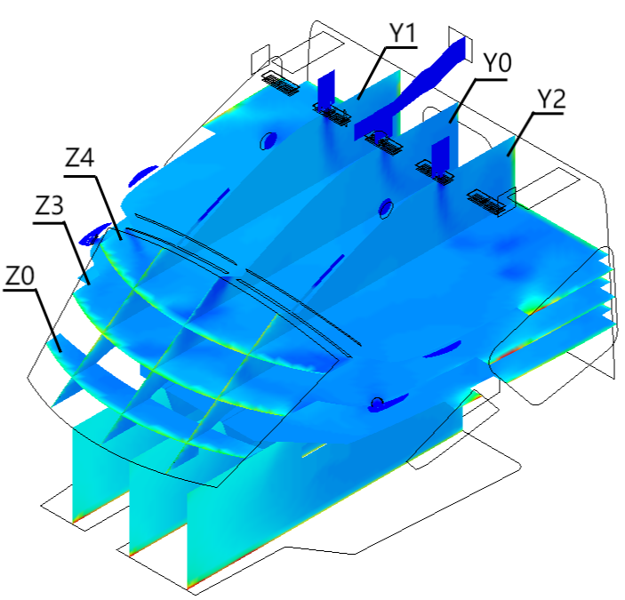
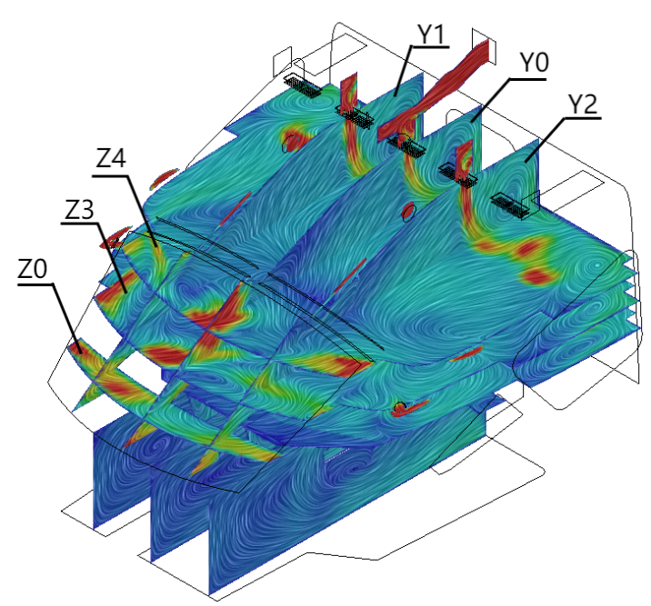
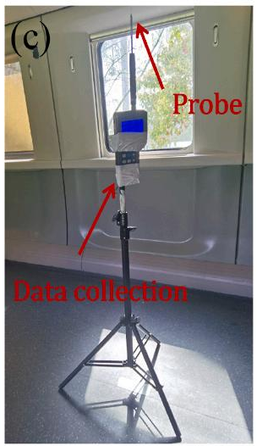
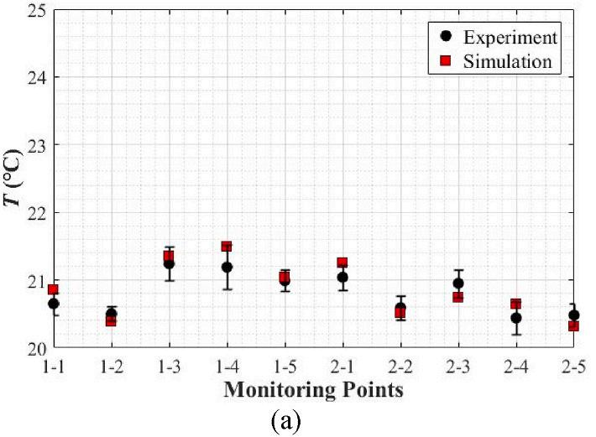
Numerical Modeling (CFD), undergraduate thesis & RA work
Core Competencies :
CFD software application (star CCM+, ANSYS FLUENT);
Fluid dynamics and field theory;
Fundamentals of high-speed rail systems;
Experimental design and execution.

Slide 12
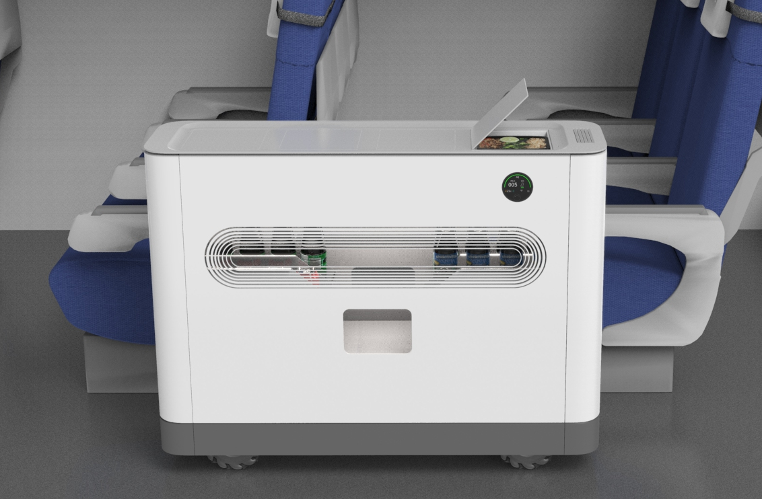
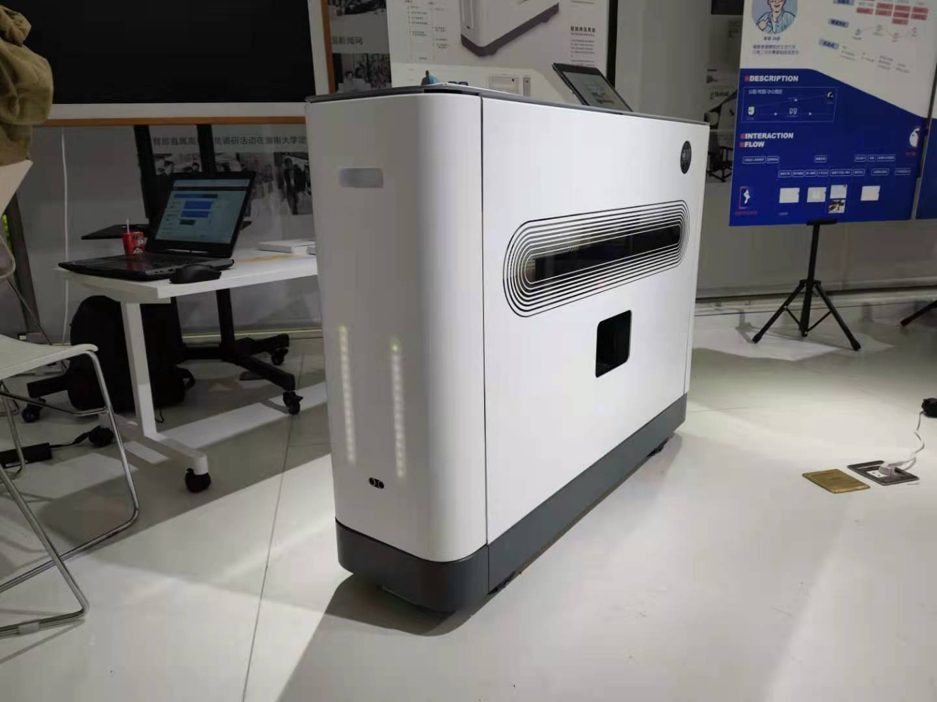
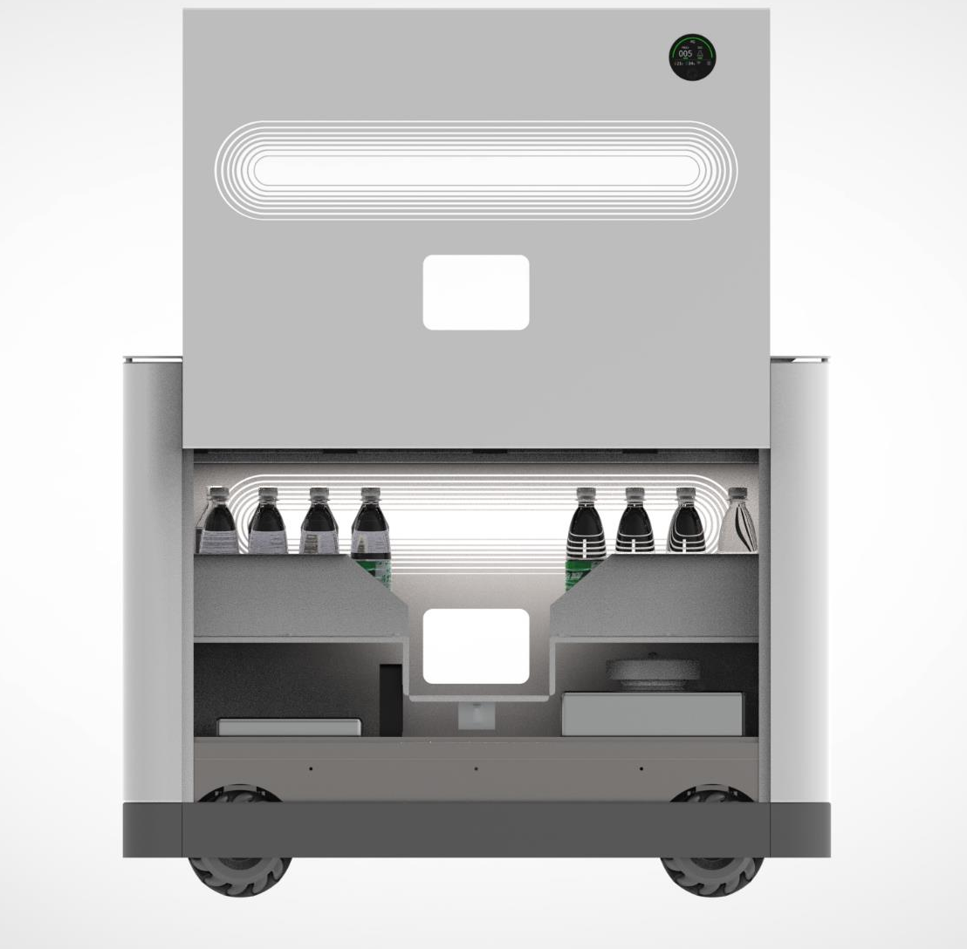
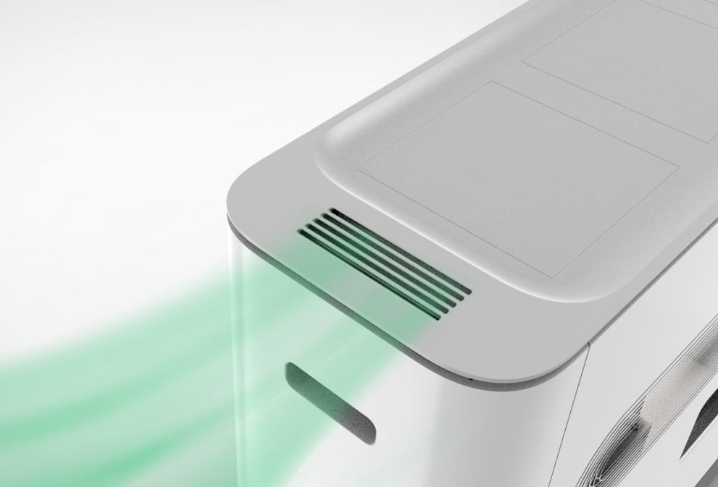
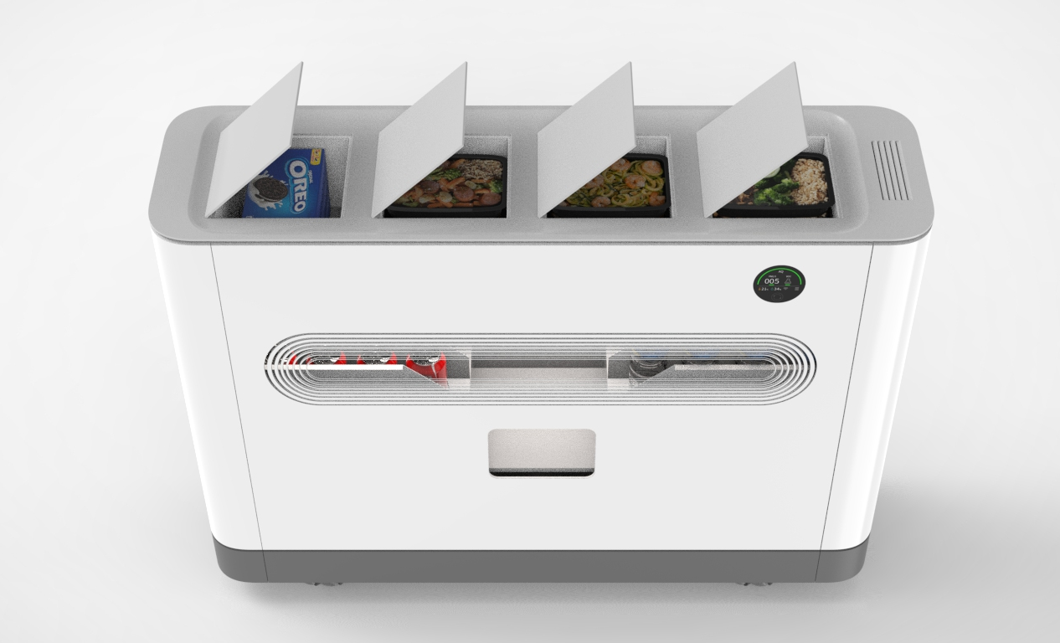
Original Invention (Robotics)
Rending Picture
Material Photo

Slide 13
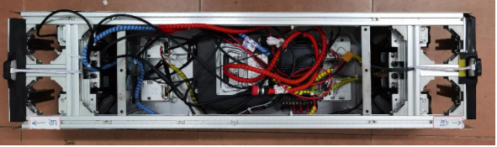
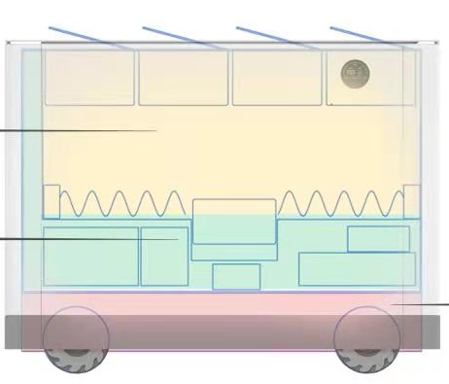
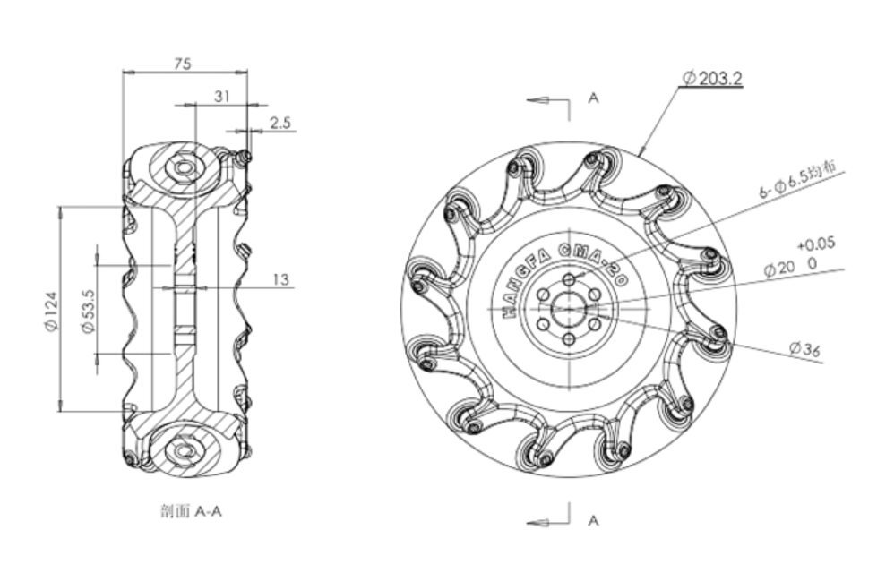
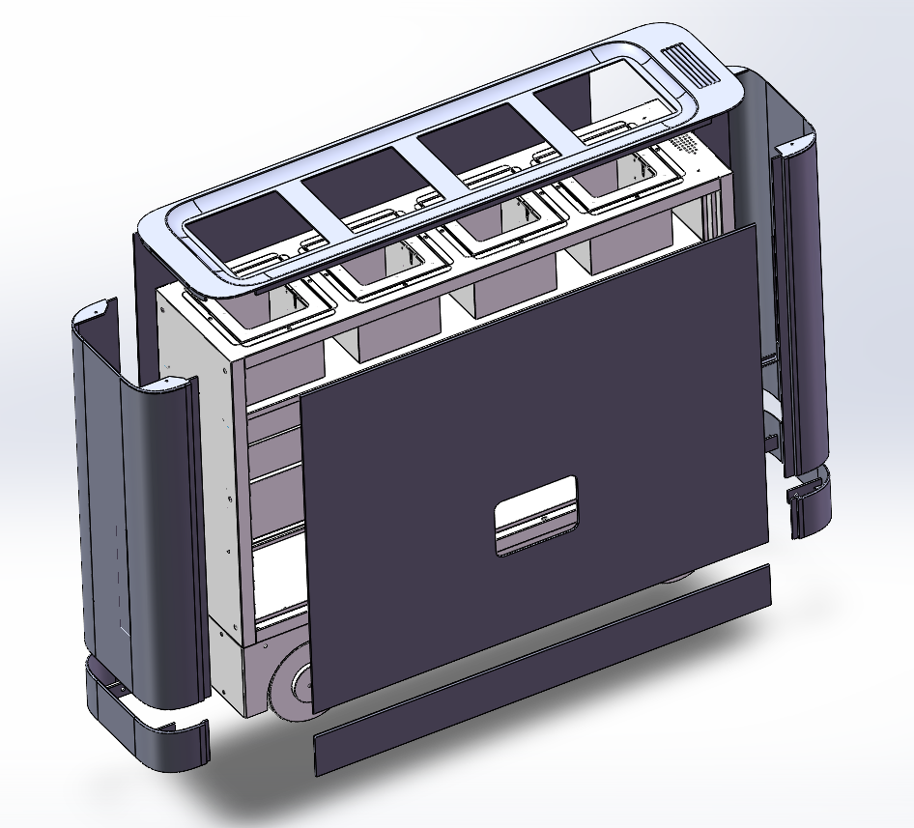
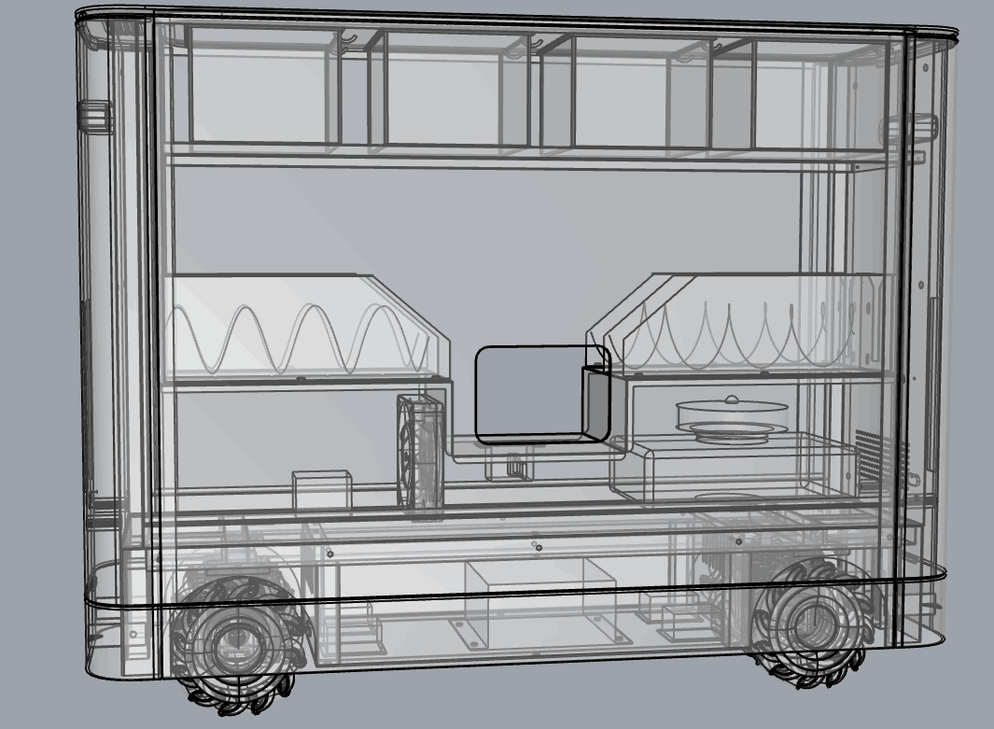
Original Invention (Robotics)
Core Competencies :
Comprehensive modular mechanical design for robotic systems;
Development and integration of SLAM Pathfinding System (RRT);
Custom modification design for non-standard Mecanum wheels;
Application and optimization of sensor technology;
Implementation of cost-reduction strategies.
Vending Section
Air purificationSection
Walking Chassis

